Slide 1

Global Tier 2 Toolkit

Slide 2
overview
The Global Tier 2 Toolkit was developed to assist corporations with growing Tier 2 efforts beyond borders, providing a guideline and best practices sharing from successful corporate global initiatives.
As procurement and tracking efforts vary by company, this is not meant to be an exhaustive list, but provides key information and strategic guidance.
Toolkit Components​:
Includes definitions, editable calculators, infographics, and charts to guide best practices.​

Slide 3
Items to have in pace prior to going global
A corporate policy which includes global Tier 2 initiatives
Active senior leadership support for global Tier 2 efforts
A functional global Tier 1 supplier diversity initiative
Resources to develop a sustainable global Tier 2 effort
A well-established Tier 2 effort with prime suppliers
Data reporting system to capture Tier 2 spend

Slide 4

Definitions
Definition of Tier 2 Spend​
Tier 2 spend is the expenditure by prime suppliers with diverse businesses that support their operations, crucial for supplier diversity
programs.​
Direct and Indirect Spend​
Direct spend relates to customer contracts, while indirect spend supports general business operations, highlighting different spending categories.​
Global Certification Criteria​
Spend definitions follow WEConnect International’s criteria including certified women-owned and underutilized suppliers for accurate reporting.

Slide 5
Spend types
Direct Tier 2 Spend
Direct Tier 2 spend involves goods or services supplied specifically for a customer’s contract by diverse suppliers.
Indirect Tier 2 Spend
Indirect Tier 2 spend covers expenses that support supplier operations like office supplies and catering services.
Importance of Differentiation
Distinguishing direct and indirect spend is vital for compliance and strategic procurement reporting.

Slide 6
Suggested action steps
Develop internal and external communications plan and training materials
Establish a strategy around Tier 2 reporting
Will there be a pilot? If yes, which countries and commodities will be
included?
Establish goals for Tier 2 global spend
- By GEO, Country, Top Prime Suppliers…etc
Review and develop Tier 2 RFP and contract language
- see attached Samples

Slide 7
Suggested action steps, continued
Survey primes to determine if there is an existing program or if it is new
Develop external trainings for suppliers, in the following categories:
Suppliers with established supplier diversity and inclusion efforts
Suppliers without formal supplier diversity and inclusion efforts
Incorporate Tier 2 results in prime suppliers’ performance scorecards
Work with supplier diversity and inclusion focused NGOs such as WEConnect International
Work with under-performing supplier to improve performance

Slide 8
Calculation method
Proportional Allocation Method
(Most common for indirect spend)
Formula:
Indirect Tier 2 Spend = (Total Spend with Diverse Suppliers) × (Customer’s Share of Total Sales)
Input​ | Description​
Total Diverse Spend​ | Total annual spend with certified diverse suppliers​
Customer Share of Sales​ | Percentage of total sales attributed to the customer​
Indirect Tier 2 Spend​ | Calculated as Total Diverse Spend × Customer Share​

Slide 9
Calculation method
Direct attribution Method
Description: The prime supplier reports actual spend with diverse suppliers that directly supports the customer’s contract.
Use Case: When the prime can track which diverse suppliers are working on the customer’s specific projects.
Pros: Most accurate and transparent.
Cons: Requires detailed tracking and reporting systems.

Slide 10
Calculation method
Percentage-based Method
Description: The prime supplier applies a fixed percentage of their total diverse spend to each customer, based on agreed guidelines.
Use Case: When detailed sales data is unavailable but a standard allocation is acceptable.
Pros: Simple and quick.
Cons: Arbitrary; may not reflect actual business share.

Slide 11
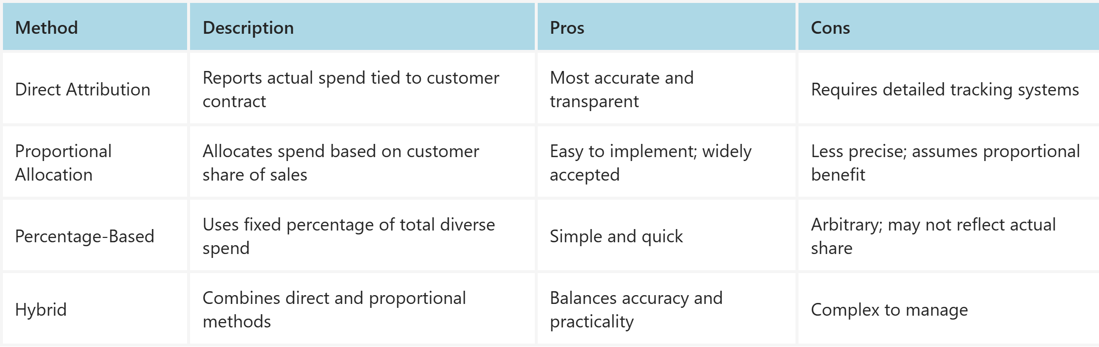
Calculation methods
Method comparison

Slide 12
GLOBAL IMPLEMENTATION BEST PRACTICES
Use proportional method for indirect spend when direct attribution is not feasible.
Ensure transparency by documenting calculation logic in supplier agreements.
Adapt methods to regional compliance requirements (e.g., EU vs. US reporting standards).
Provide training and templates for suppliers to standardize reporting.
Regularly audit Tier 2 data for consistency and integrity across regions.
Leverage technology platforms (SupplierGATEWAY, Coupa) for automation and accuracy.

Slide 13
GLOBAL IMPLEMENTATION STRATEGIC RECOMMENDATIONS
Leverage Networks​ - Partner with organizations like WEConnect International, that provide certified suppliers and regional expertise to enhance your impact sourcing program.
Set Measurable Goals​ - Establish clear objectives and integrate reporting into procurement to track inclusive sourcing progress.​
Educate Stakeholders​ - Train internal teams on the importance and benefits of inclusive sourcing for organizational success.​

Slide 14
Questions? Please reach out to: membersupport@weconnectinternational.org

Slide 15
appendix

Slide 16
Tier 2 Clause, Sample 1
Each quarter, Vendor shall (XXX) report the total dollar amount spent with all certified minority and woman owned suppliers and subcontractors involved in providing goods and services to (XXX) from all countries where (XXX) has operations and/or goods and services are sourced from, provided there are certifying organizations in-place, and the percentage of Vendor’s total sales represented by the total sales made by the Vendor to (XXX). This information shall be provided to (XXX) within 45 days after the end of each Calendar Quarter and shall be submitted to (YYY) and shall be provided in an acceptable format requested by (YYY). If Vendor does not currently track minority and woman owned purchases, it represents and warrants that within one year of the Execution Date of this Agreement, it shall implement a program to comply with this Section.

Slide 17
Tier 2 Clause, Sample 2
Supplier will procure a minimum of (insert number) percent of its total subcontracts with Diverse Business Enterprises. Supplier will track and maintain spending data by country with such Diversity Business Enterprises and will report Second Tier Direct Expenditures and/or Second Tier Indirect Expenditure to Buyer by the 45th day of the month following the close of each calendar quarter on forms designated by Buyer or formats approved by Buyer. Supplier’s initial report shall be due at the end of the quarter following execution of this Agreement. If Supplier requires a delay in the report, Supplier will notify Buyer who will inform the (XXX) Supplier Diversity team and the parties will discuss a revised due date.

